Slide 1


PRESENTATION
CASE STUDY
Rifki C. Nugraha

Slide 2

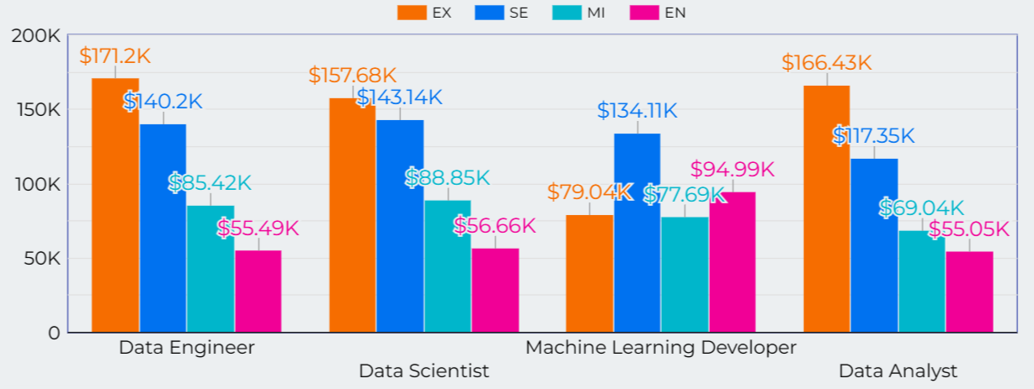
JOB TITLE
VS
SALARY
Based on the average salary chart of each role, it is found that Data Engineer ranked first with an average of 109.81k USD. Then followed by Data Scientist, Machine Learning Developer, and Data Analyst. The higher the position, the higher the average salary. But unlike Machine Learning Developer data, it can be seen that the average Executive Level salary is lower than Senior and Entry Level. This turned out to be due to the limited practitioners of ML Dev, there is only 1 person in the company in the Middle Income country.

Slide 3
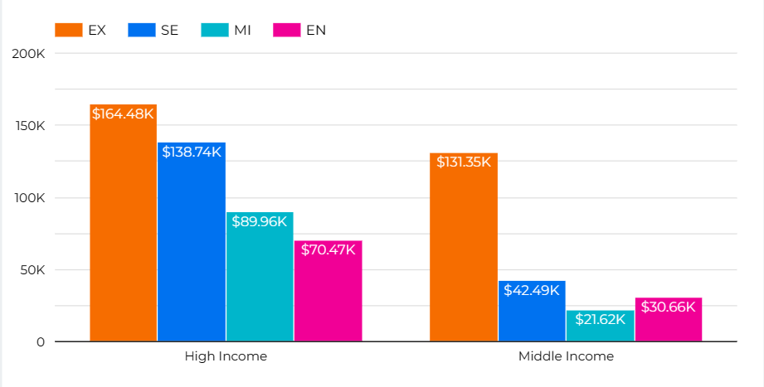

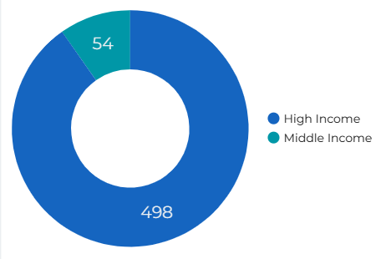
Average Salary between High Income Country and Middle Income Country
High Income VS
Middle Income
Comparison of the Number of Workers in High Income and Middle Income Countries
The majority of workers are in high income countries. It is generally seen that, the average salary in high income countries is much greater than middle income. Even for the Executive (EX) level in the middle income country, it is still inferior to the Senior (SE) level in the high income country.

Slide 4
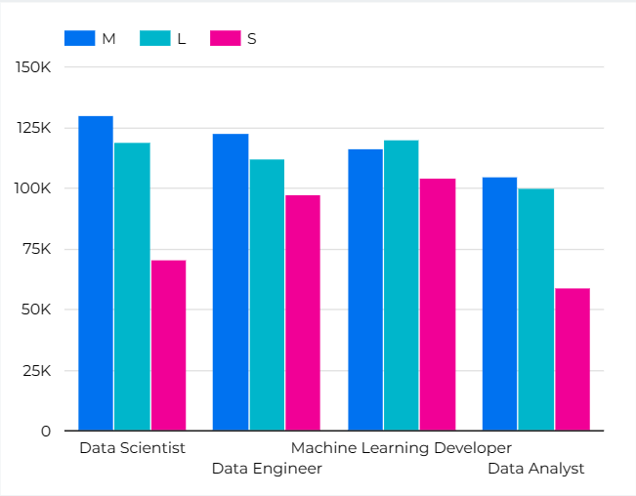
Company Size VS
Avg Salary
……..
Large companies do not provide a higher average salary than medium and small companies. Only Machine Learning Developer jobs provide higher average salaries. Medium-sized companies provide higher salaries on average.
……….

